Slide 1

Employee Attrition Analysis
View in Power BI

Slide 2
PROBLEM STATEMENT
XYZ company which was established a few years back is facing around a 15% attrition rate for a couple of years. And it's majorly affecting the company in many aspects. In order to understand why employees are leaving the company and reduce the attrition rate XYZ company has approached an HR analytics consultancy for analyzing the data they have. You are playing the HR analyst role in this project and building a dashboard which can help the organization in making data-driven decisions.

Slide 3
APPROACH
The main goal of the project is to find key metrics and factors and then show meaningful relationships between them based on different features available in the dataset.
Data Collection : Imported data from various datasets available in the project using Pandas library.
Data Cleaning : Removed missing values and created new features as per insights.
Data Preprocessing : Modified the structure of data in order to make it more understandable and suitable and convenient for statistical analysis.
Data Analysis : I started analyzing dataset using Pandas, Numpy, Matplotlib and Seaborn.
Data Visualization : Plotted graphs to get insights about dependent and independent variables. Also used Power BI for data visualization.

Slide 4
QUICK INSIGHTS
There are 3 different
Departments
There are 9 different
Job Roles
4410
Total Employees
'Research & Development' accounts for the majority of Employees
'Travel_Rarely’
accounts for the majority of Employees

Slide 5
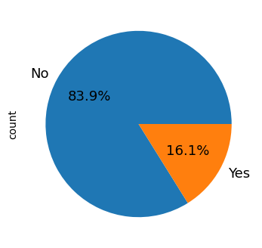
Distribution of Attrition
83.9% of Employees are going to leave the company and 16.1% of employees will stay.

Slide 6
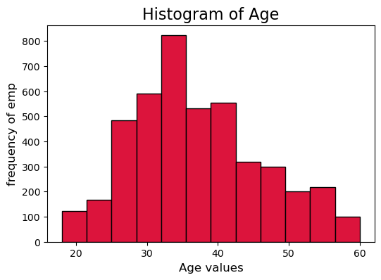
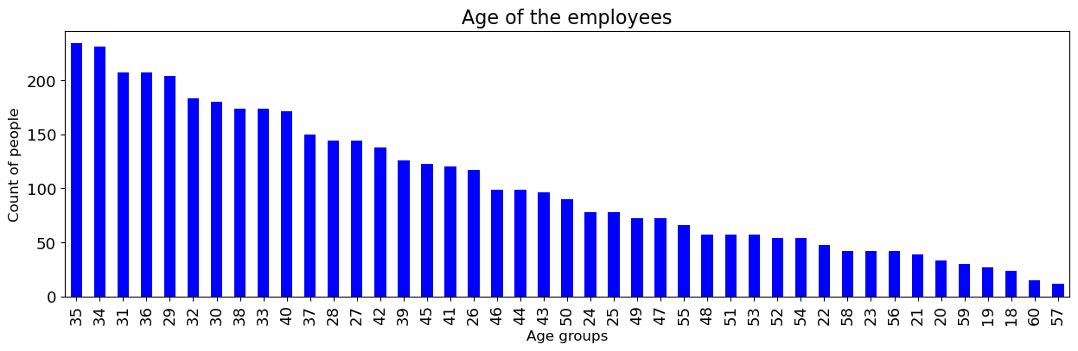
Histogram of Age
Age between 30 – 40 are likely to leave the company.

Slide 7
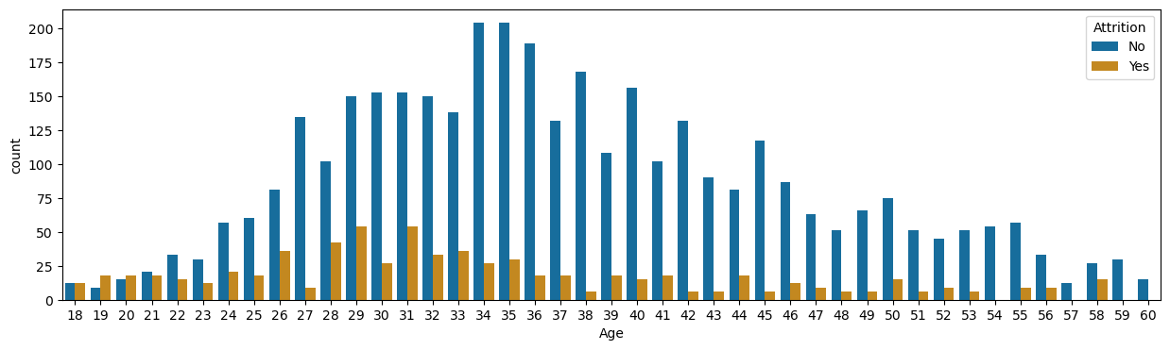
What age group is more likely to leave?

Slide 8
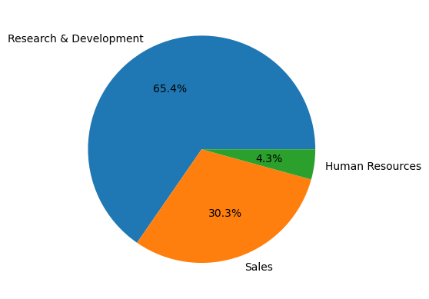
Employee count on every Department
'Research & Development' accounts for the majority of Employees

Slide 9
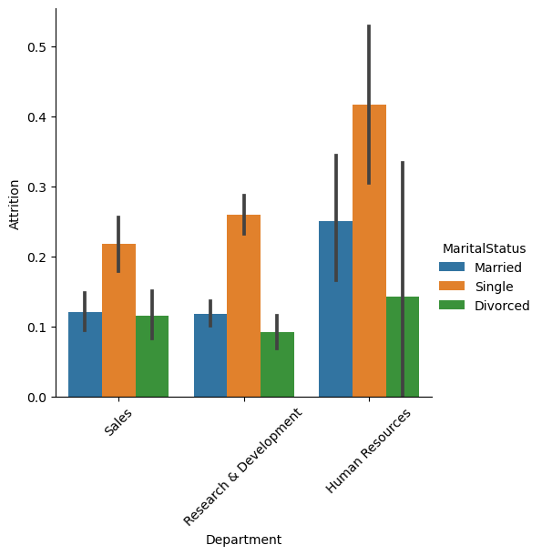
Employee Attrition based on Marital Status

Slide 10
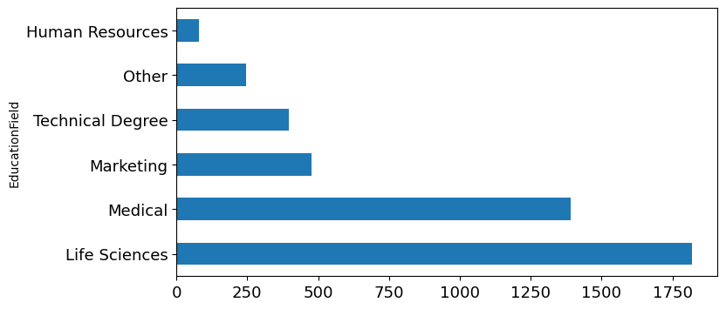
Employee count based on Education Field
Employees who studied Life Science are maximum when compared to other Education Fields

Slide 11
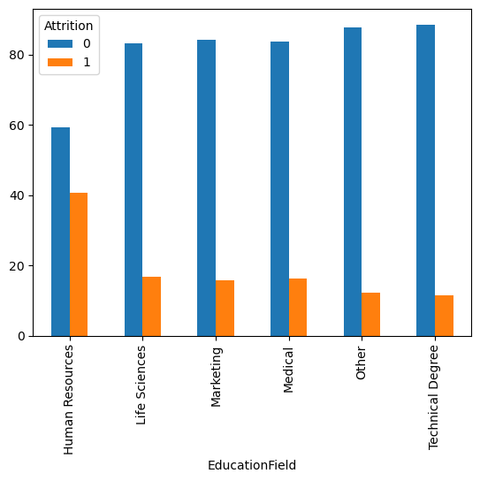
Can low salary be one of the reason for Attrition?
No, Because even though the salary of HR and marketing employees is higher, their leaving rate is highest.

Slide 12
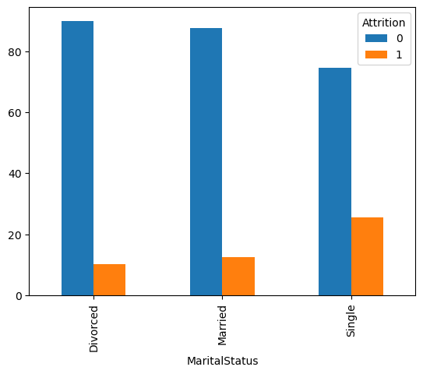
Who is leaving more? married ,un-married or divorced employees?
Singles tend to have a little higher attrition rate than others.
Single employee has high attrition rate(25%) compared to average attrition rate of 16%.Similarly, divorced employees have low attrition rate(10%) compared to the average of 16%.

Slide 13
DATA VISUALIZATION ( EMPLOYEE ATTRITION ANALYSIS )
View in Power BI

Slide 14
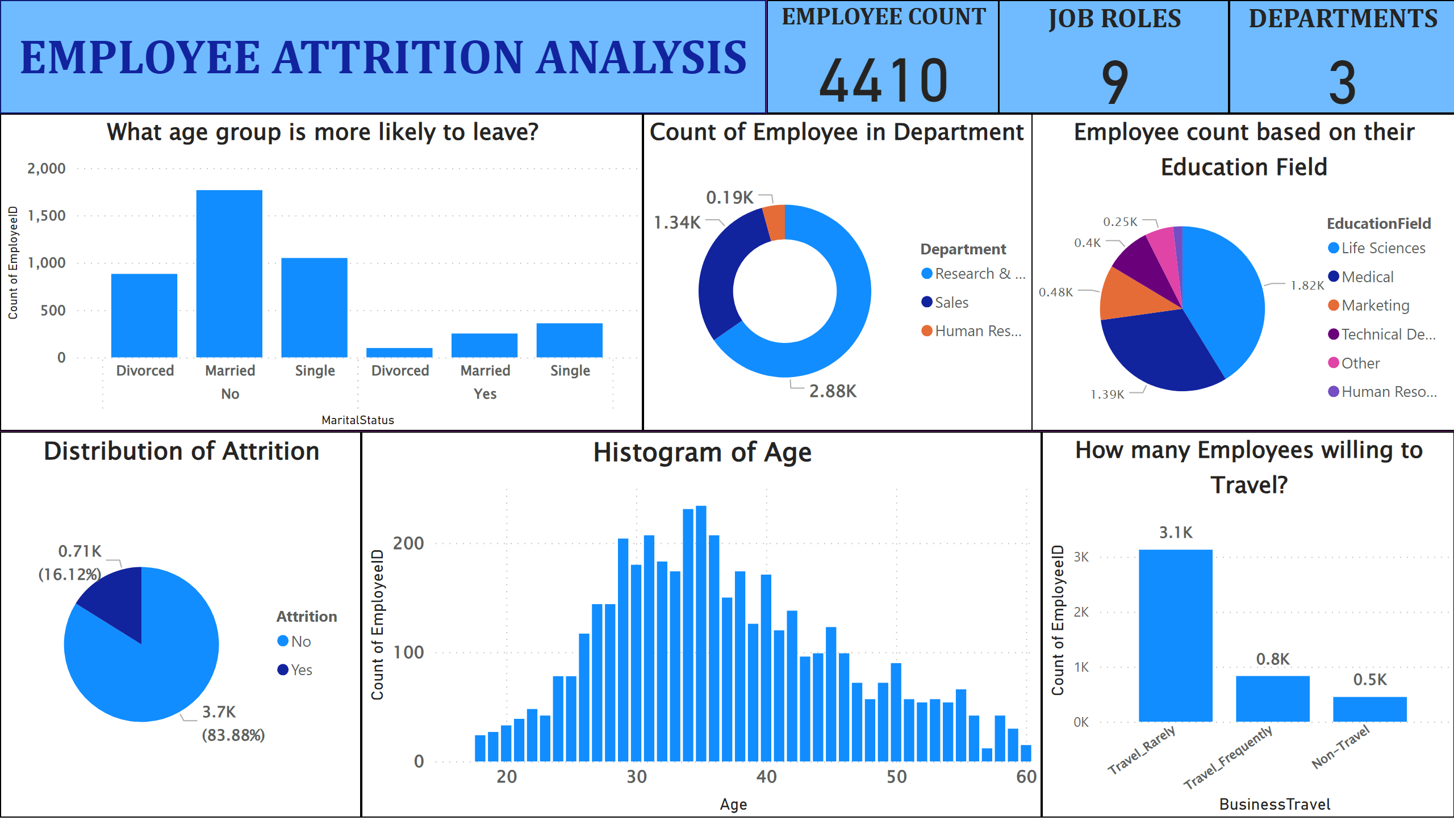

Slide 15
Conclusion
83.9% of Employees are going to leave the company and 16.1% of employees will stay.
Age between 30 – 40 are likely to leave the company.
'Research & Development' accounts for the majority of Employees
Employees who studied Life Science are maximum when compared to other Education Fields
Even though the salary of HR and marketing employees is higher, their leaving rate is highest.
Singles tend to have a little higher attrition rate than others.

Slide 16
THANK YOU….

